Slide 1

Workplace Pension Reform:
an introduction to automatic enrolment
The government are introducing major changes to workplace pensions. Make sure you know how you will be affected with this handy guide.
YOUR LOGO
HERE

Slide 2
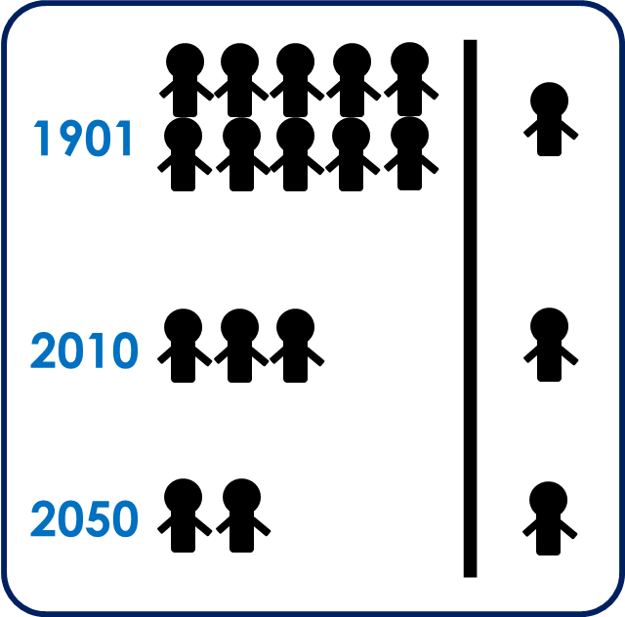
What is workplace pension reform?
Workplace pension reform (WPR) is the new legislation that states workers need to be automatically enrolled on a nominated pension scheme, when they meet certain criteria. Automatic enrolment is the mechanism behind this process. A common belief is that automatic enrolment is workplace pension reform, this is not the case.
Why is it being introduced?
People are living longer, with healthier lifestyles; as a result the ratio between the workforce and those at a pensionable age is decreasing. People are also planning and saving less for their retirement. The current state pension cannot sustain this change so as a result, workers are being encouraged to save for their retirement through workplace pension schemes.
Leading industry experts suggest you should start preparing for Auto Enrolment 18 months before your staging date, so you should already be thinking about the next steps you need to take!
In 1901 there were 10 workers for every 1 pensioner. In 2010 this had dropped to 3 workers to every pensioner. By 2050 it is estimated to have dropped to just 2 workers to every pensioner.
1901
2010
2050
YOUR LOGO
HERE

Slide 3
Key terms and definitions
Automatic Enrolment (AE) – The process in which Eligible Jobholders, who are not already a member of a qualifying scheme, must be automatically enrolled into a qualifying pension scheme.
Department for Work & Pensions (DWP) – Policy owner and responsible for enabling and coordinating activity for the programme. Defines the communication required between employers and employees.
NEST (National Employment Savings Trust Corporation) – A pension provider available to all employers who want to use it. NEST is a workplace pension scheme designed for automatic enrolment that is available to any UK employer regardless of the organisations’ size.
Opt In – A jobholder has the right to ‘Opt In’ to an automatic enrolment scheme, unless they are:
  An active member of a qualifying scheme with that employer.
  An eligible jobholder for whom the employer has an automatic enrolment duty.
Opt Out – Eligible jobholders may choose to ‘Opt Out’ after they have been automatically enrolled. Non-eligible jobholders who have opted in may choose to ‘Opt Out’ after they have been enrolled. Workers who have been enrolled under contractual enrolment and entitled workers who have asked to join a scheme do not have the right to choose to ‘Opt Out’. If they want to leave the scheme, they must cease membership in accordance with the scheme rules.
Eligible jobholder
  Aged between 22 and the state pension age (SPA)
  Working in the UK
  Earning above the minimum earning threshold (currently £8,105)
Non-eligible jobholder
  Aged between 16 and 21 or SPA and 74
  Working in the UK
  Earning above the minimum earning threshold
  OR
  Aged between 16 and 74
  Working in the UK
  Earning above the lower earnings threshold (currently £5,564) but below the minimum earning threshold
YOUR LOGO
HERE

Slide 4
Key terms and definitions
Entitled workers
  Aged 16-74
  Working in the UK
  Earning below the lower earnings threshold
ORIGO – An ecommerce standards and services body for the UK financial services industry. Represents several pension providers.
Postponement Date – Postponement allows the employer to postpone the automatic enrolment process for up to 3 months. This can be for:
  All employees (can only be postponed at staging date)
  Selected individuals (can be postponed at staging date or when they trigger automatic enrolment)
  Groups of employees e.g. new starters (can be postponed at staging date or when they trigger automatic enrolment)
Qualifying Earnings – The earnings used to identify whether an employee is an eligible jobholder or a non-eligible jobholder and their level of contributions.
  When a worker is paid in arrears, the employer considers what is due to be paid in this period regardless of what period it is earned.
  Includes: salary, wages, commission, bonuses, overtime, SSP, SMP, OSPP, ASPP, SAP.
Staging Date – The date when businesses must start the automatic enrolment process
The Pensions Regulator (TPR) – The UK regulator of work-based pension schemes. Responsible for auditing companies ensuring that employers are compliant with the WPR legislation
The Pensions Advisory Service – An independent non-profit organisation that provides free information and guidance on the whole spectrum of company, personal and stakeholder schemes.
YOUR LOGO
HERE

Slide 5
What do I need to do to prepare for automatic enrolment?
1) Know your staging date – you can find this out on page 7
2) Assess your workforce for eligibility
3) Review your current pension arrangements
4) Communicate the changes to all your workers
5) Automatically enrol your ‘eligible jobholders’
6) Register with The Pensions Regulator and maintain records
7) Contribute to your workers’ pensions
8) Look our for up and coming guides we will be releasing or contact us to see how we can help you prepare for automatic enrolment
YOUR LOGO
HERE

Slide 6
What is a staging date and how is it determined?
Workplace pension reform is being rolled out in stages, known as “Staging Dates”
A small employer (with fewer than 50 workers as of 1st April 2012) who has a staging date on or before 1st April 2015, may choose to move their staging date to a pre-prescribed alternative date between August 2015 and April 2017
Staging for larger employers has already begun – with the largest employers staging from October 2012
Staging date is based on the PAYE data provided to The Pensions Regulator (TPR) by HMRC on 1st April 2012 – employers will then be contacted by TPR 12-18 months before their staging date and then again 3 months before their staging date
Employers may not know their PAYE count, as it is not necessarily equal to the number of employees
Employers may have an earlier staging date if they have at least one person paid under a PAYE scheme larger than the employer’s “main PAYE” (e.g. parent company’s PAYE reference)
Can I move my staging date?
Employers may bring forward their staging date to be seen as forward thinking, to offer as a benefit package for employees or to align with certain periods in their payroll calendar (e.g. If staging date is at busiest time, bringing it forward can alleviate some pressure)
Employers can bring forward their staging date but once it has been moved forward it cannot be moved back
To bring the staging date forward employers must have an existing staging date and must have contacted a pension scheme that can be used to comply with employer duties.
If you bring your staging date forward, the new date must be the 1st of the month and you must take the following steps :
  Obtain an agreement that the selected scheme can fulfil the duties from the new staging date
  Agreement must be obtained from: the trustees or managers, for occupational pension schemes, or the provider, for personal pension scheme, or the scheme administrator as registered with HMRC
  Notification must be in writing and TPR must be notified at least one calendar month before the new staging date
YOUR LOGO
HERE

Slide 7
When is my staging date?
As previously mentioned, your staging date depends on the number of people on your largest PAYE scheme as of 1st April 2012.
To ensure you know your correct staging date please use the link below or contact The Pensions Regulator customer support.
http://www.thepensionsregulator.gov.uk/employers/tools/staging-date.aspx
A basic summary is shown in the tables below.
YOUR LOGO
HERE

Slide 8
What is postponement?
Postponement allows the employer to postpone the automatic enrolment process for up to 3 months. This can be for:
All employees (can only be postponed at staging date)
Selected individuals (can be postponed at staging date or when they trigger automatic enrolment)
Groups of employees e.g. new starters (can be postponed at staging date or when they trigger automatic enrolment)
Why would employers choose to use postponement?
Bring the automatic enrolment process in line with their payroll process.
Provide a method of avoiding a spike in income for those who would usually not qualify for automatic enrolment.
Provide a method of leaving seasonal workers out from the process.
Some employers are using postponement to give themselves more time to prepare.
Postponement Rules
If an employer wants to use postponement they must issue the employee with a tailored postponement notice or a “General Notice”.
The employer needs to decide on the ‘deferral date’.
“General Notice A” can be used to serve all employees.
YOUR LOGO
HERE

Slide 9


When can I use postponement?
Joe is a new employee. His probation period is 3 months. Can postponement be used for new employees?
Postponement can be used in this situation as long as it is communicated to Joe.
Yes
I take on seasonal workers. Can I use postponement?
Postponement can be used in this situation as long as it is communicated.
Yes
I have already used postponement for Joe. But I have had to extend Joe’s probation period. Can I use postponement again?
Joe must be reassessed on the last day of postponement, and if he meets the criteria of an eligible jobholder he must be automatically enrolled.
No
YOUR LOGO
HERE

